Slide 1


TERM 1 & 2 PROJECT ON EDA OF FACEBOOK

Slide 2
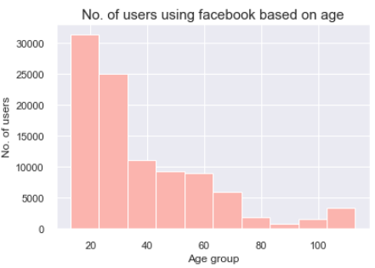
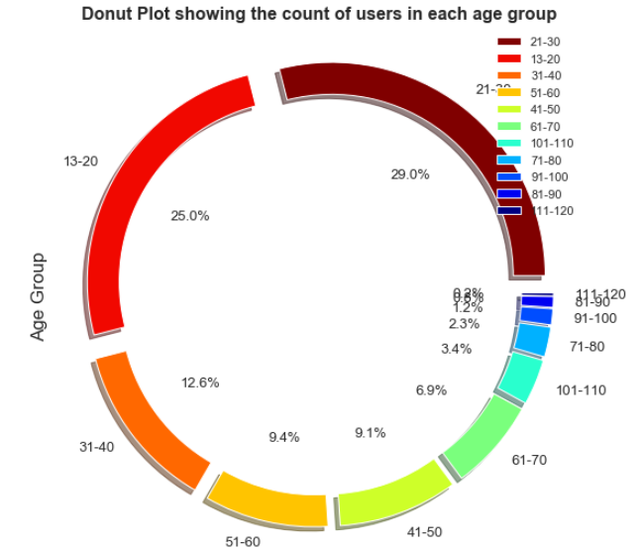
Which age group use facebook more?
Younger generation from 13-30 years are heavy users of Facebook

Slide 3
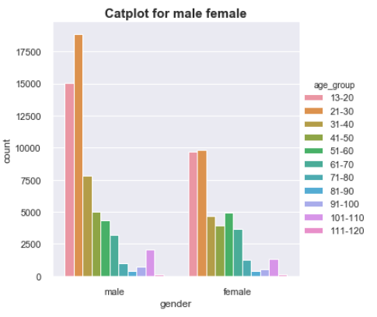
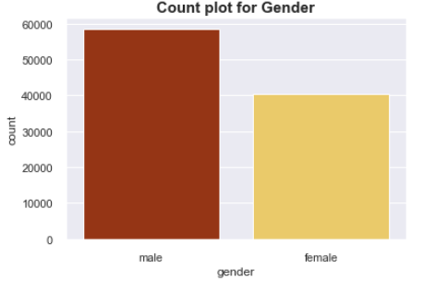
Which gender use facebook more
Male users are more than Female users
Age group wise representation for both Male and Female

Slide 4
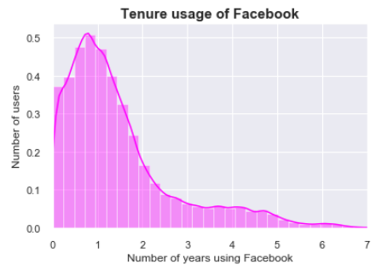
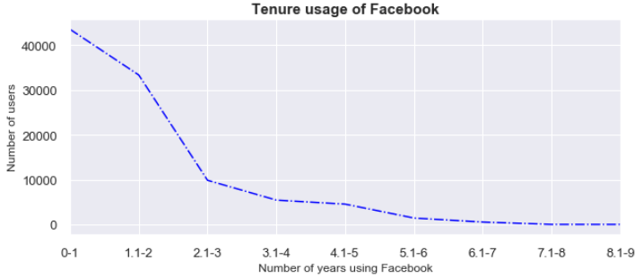
What is the tenure of usage of facebook users
Tenure is rightly skewed and which shows facebook users are more active for a time period of 0-1.5 years and insight is to enhance features for longeivty of users

Slide 5
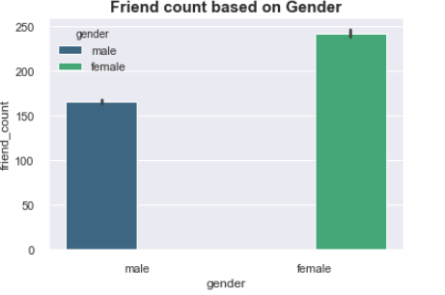
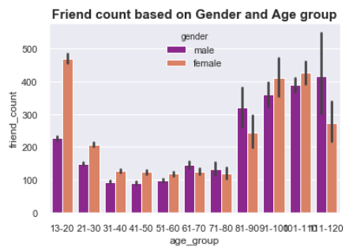
Who(Based on gender) has more friend count
Interestingly female has more friend count than male. In majority of age groups female has more friend count than Male till 60 years of age and surprisingly male has more friend count after 60 years, but over all trend is female has more friend count

Slide 6
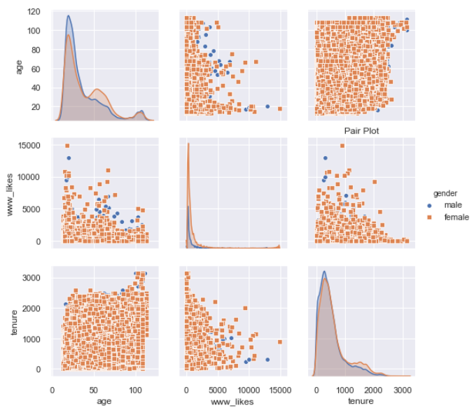
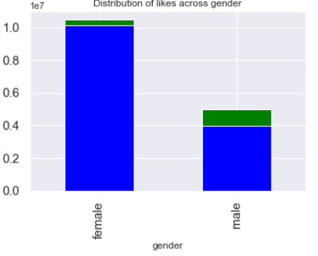
What is the distribution of likes across gender
Female are more active in posting the responses in facebook in form of likes.

Slide 7
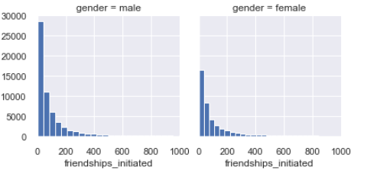
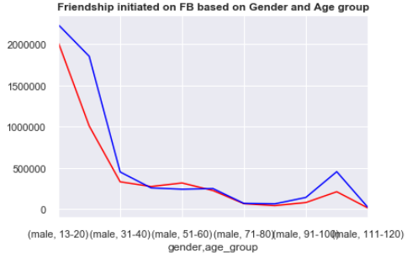
Who(Gender) has initiated more friendship requests on fb
Red line shows friendships initiated by female and Blue line shows friendships initiated by male . Male users have initiated friendship more

Slide 8
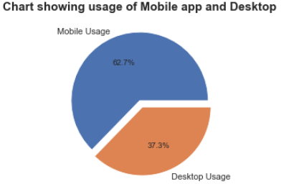
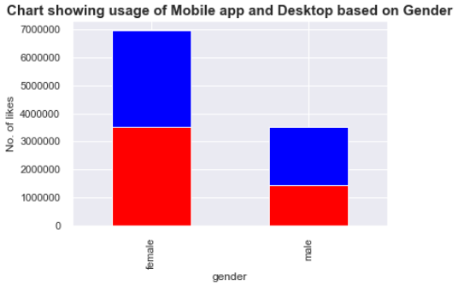
Which are more used to access FB, either desktop or mobile
More users(around 60%) access facebook through Mobile and around 40% users are accessing thru desktop.

Slide 9
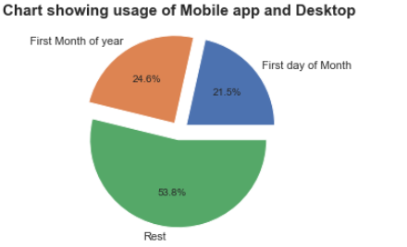
Detecting Fake/Dummy Accounts
Among users having 0 friend count , in that close to 50% users are having first month of year and first day of month as their month and day of birth which gives insight as they are either fake/Dummy accounts

Slide 10
Conclusion
Male users are more on Facebook and Facebook should put marketing efforts to attract female users
Age group between 13-30 are heavy users of facebook and again this is area of scope to attract other age group users too
As more users are accessing facebook through app , more development and features can be brought to mobile app, so that it can attract more users.
Identifying more Fake/Dummy accounts from time to time and work on deleting those kind of users from Facebook

Slide 11
THANK YOU

